Slide 1

New Kid on the Block: Getting Started with Alpine

Slide 2
New Kid on the Block: Getting started with Alpine
Website: www.rc.colorado.edu
Helpdesk: rc-help@colorado.edu
Slides: https://github.com/ResearchComputing/New_User_Seminar
Survey: http://tinyurl.com/curc-survey18
Presentation prepared by Trevor Hall, CURC

Slide 3
Learning Goals
CU Research Computing (CURC) and Alpine cluster basics
Using CURC and Alpine resources
Navigating Research Computing
Alpine Software
Moving your data
Running a job (time allowing)
Help!

Slide 4

Things to take note of:
Confusing, ambiguous, highly nuanced concepts
Our goal is to help you avoid common mistakes, pitfalls, and frustrations
Ask Questions!

Slide 5
CU Research Computing and Alpine basics

Slide 6


CURC Resources Include:
High Performance Computing (HPC)
Storage of Research Data
High-Speed Data Transfer
Data Sharing
Cloud Computing
Training and Education
Secure Research
Notes:
Can advise on Secure Research, have a CMMC environment (Preserve) available (let know available if doing DoD or DoE things)

Slide 7
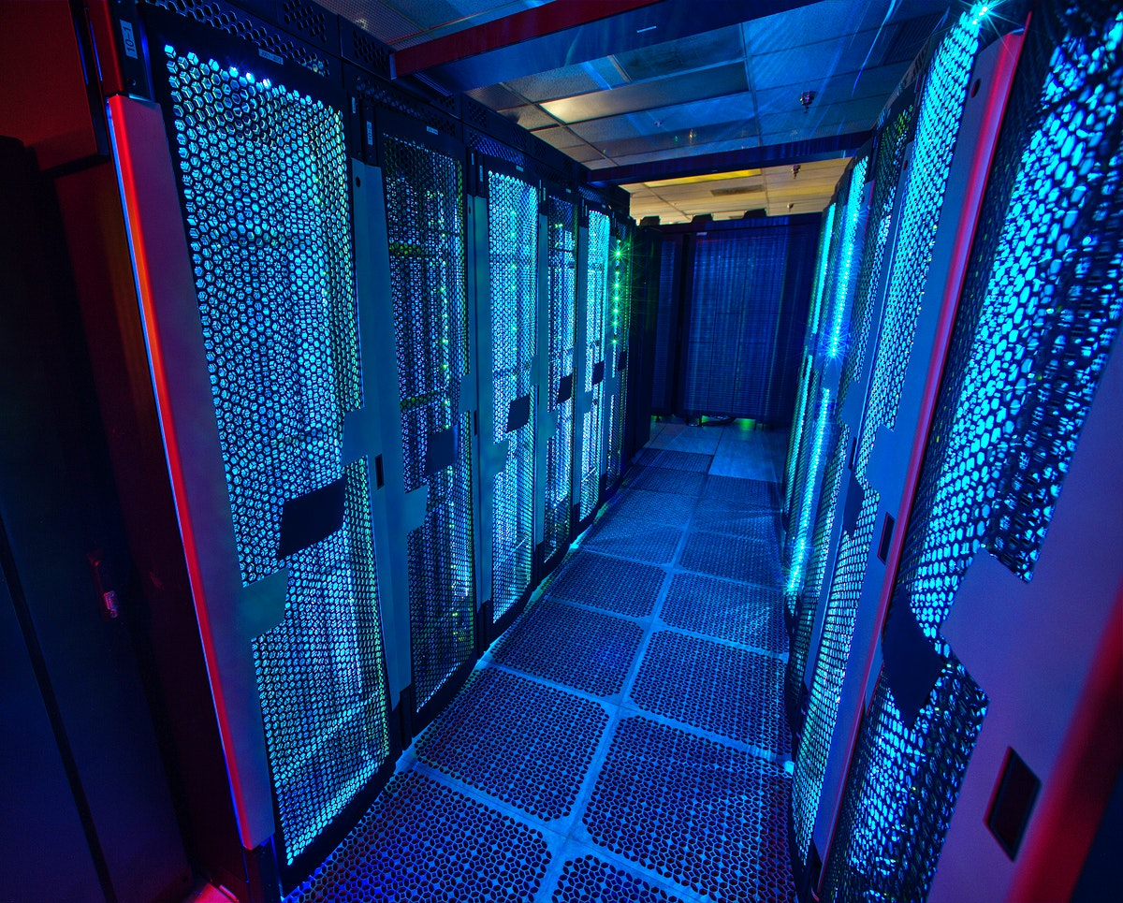
CURC is primarily known for:
High Performance Computing (HPC)

Slide 8
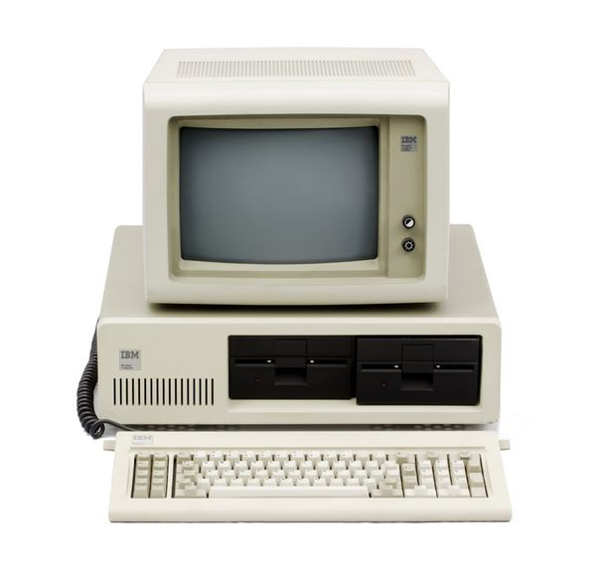
What can I use HPC for?
Jobs that would take a long time on local machines can instead be distributed over hardware:
Parallelized to split up then joined (if software enabled)
Broken up into many serial jobs
BIG Job
Results
Tiny Job
Tiny Job
Results
Tiny Job

Slide 9
CURC HPC Cluster: Alpine
Alpine is the 3rd-generation HPC cluster at CURC, following:
Janus
RMACC Summit
Alpine is a heterogeneous cluster with hardware currently provided by CU Boulder, CSU, and Anschutz
Access available to CU Boulder, CSU, AMC and RMACC users
Alpine

Slide 10
HPC Cluster: Alpine
Hardware on Alpine will continue to be purchased and released in stages:
Alpine (stage 3):
347 General CPU Nodes
AMD Milan, 32,48,64 Core, 3.74G RAM/Core
12 NVIDIA GPU Nodes
3x NVIDIA A100 (atop General CPU node)
8 AMD GPU Nodes
3x AMD MI100 (atop General CPU node)
22 AMD High-Memory Nodes
AMD Milan, 48,64 Core, 21.5G RAM/Core
Additional Hardware contributed by CSU, AMC
Nodes which boost priority for CSU/AMC users
Alpine
Notes:
AMC – must sign end user agreement

Slide 11
HPC Cluster: Alpine
Interconnect
CPU nodes: HDR-100 InfiniBand (200Gb inter-node fabric)
GPU nodes: 2x25 Gb Ethernet +RoCE
Scratch Storage: 25Gb Ethernet +RoCE
Operating System
RedHat Enterprise Linux version 8 operating system
Alpine

Slide 12
Using CURC and Alpine resources

Slide 13
How to Access RC Resources?
Get an RC account
Set up two-factor authentication with Duo
(Inform us of any specific needs)
Log in
Create greatness! (responsibly)

Slide 14
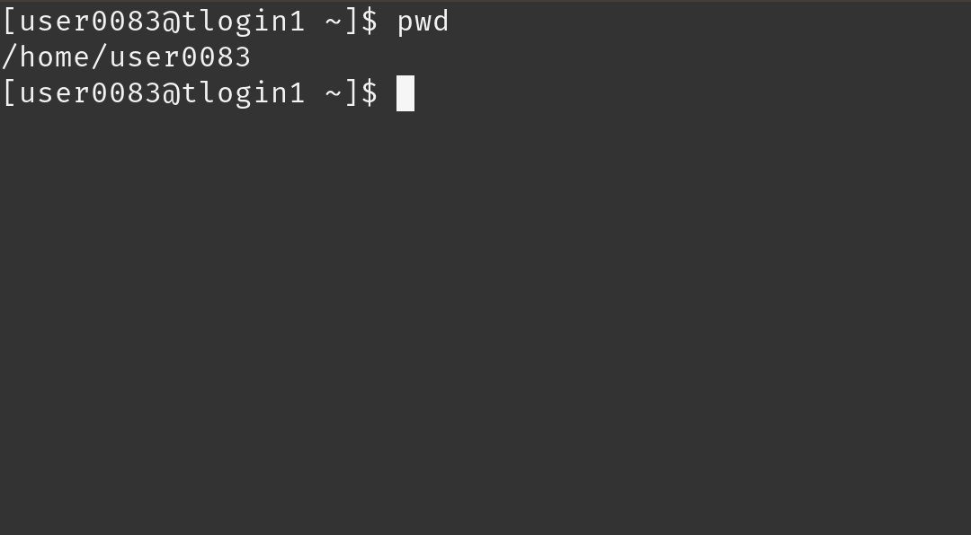
Accessing CURC
Mac or Linux
Terminal application
Windows
PuTTY
Powershell
Open OnDemand (alternative for CU affiliates)
For those less familiar with Linux (ondemand.rc.colorado.edu/)

Slide 15
Node Types
Login | Compile | Compute
Where you log in to For editing code, job submission No heavy computation | Where you compile code, install packages Explore the Alpine software environment Edit code, submit jobs No heavy computation | Where scheduled jobs run Intended for heavy computation
Ex. edit job script | Ex. Install python libs | Ex. Running Matlab

Slide 16
Navigating CURC
Node | File System
One computing server Physical hardware Work together in parallel | The basic tree-like layout From most nodes* you have access to most file systems
/
d1
d2
d3
d4
f1
f2

Slide 17
Alpine Compile Nodes
If you have used Summit in the past, compile nodes work slightly differently:
Instead of having dedicated hardware (2 nodes) which are oversubscribed for users to ssh into
Alpine’s acompile command starts an interactive job which users can compile in which provides the following benefits:
Users can request specific resources (i.e. more cores to compile with)
Limits dedicated hardware set aside

Slide 18
Alpine Software
Once logged in, type:
$ acompile
To start an Alpine compile job.
Once on a compile node, type:
$ module avail
To list currently available software
Alternatively, type:
$ module spider <software>
To search for a specific software

Slide 19
Filesystem Structure
/home (2GB) | /projects (250GB) | /scratch/alpine (10TB)
Scripts, Code, Small, important files/directories Not for sharing files or job output | Code/files/libraries Software you are installing Sharing files Not for job output | Output from running jobs Large files/datasets Sharing files Cluster specific Not for long term storage
Ex .bashrc | Ex. Shared job scripts | Ex. Data

Slide 20
Exploring the Filesystem
Once logged in use the following commands to navigate to your different workspaces
$ cd /home/<user>
$ cd /projects/<user>
$ cd /scratch/alpine/<user>

Slide 21
Moving Data to/from CURC
Globus
Web-based file transfer
FileZilla
File transfer GUI application that can be used on Windows, Mac, and Linux.
Secure Copy (scp)
Can send data to and fetch data from a remote server.
Rsync
Can be used to synchronize files and directories across two locations, which can often lead to efficiencies in repeat-transfer scenarios.
SFTP
An interactive alternative to scp that allows multiple, bi-directional transfer operations in a single session.
Rclone
Command line program to manage files on cloud storage.
Check out our documentation on File Transfer for guides to using each of these tools: https://curc.readthedocs.io/en/latest/compute/data-transfer.html

Slide 22
Using Alpine compute: Jobs
What is a “job”?
Work for the cluster to perform on
Has a unique ID
Batch jobs
Submit job script which will be executed when resources are available
Create script containing information about the job
Submit the job file to a queue
Interactive jobs
Work interactively at the command line of a compute node

Slide 23
SLURM
Simple Linux Utility for Resource Management
Through SLURM users can:
Schedule jobs on specific compute resources
Run jobs interactively or hands off
Query job statistics

Slide 24
Alpine Partitions
Partition | Description | # of nodes | RAM/core (GB) | cores/node | GPUs/node
amilan | General Compute Node: AMD Milan | 347 | 3.74 | 64 | 0
ami100 | GPU Node: 3x AMD MI100 | 8 | 3.74 | 64 | 3
aa100 | GPU Node: 3x Nvidia A100 | 12 | 3.74 | 64 | 3
amem | High-memory node | 22 | 21.5 | 48 | 0
QOS: normal (24-h), long-7-d

Slide 25
Alpine Allocations
How can I use more computational time?:
Trailhead Allocation (Default)
~2,000 SUs / Month
Ascent Allocation
250,000 SUs
Peak Allocation
>250,000 SUs
Request an allocation at https://curc.readthedocs.io/en/latest/clusters/alpine/allocations.html

Slide 26
Help! I’m stuck, where do I go?
Documentation: curc.readthedocs.io/
Trainings with Center for Research Data and Digital Scholarship (CRDDS): https://www.colorado.edu/crdds/
RC Summer Camp Slides: https://github.com/ResearchComputing/Summer_Camp_2023
Helpdesk: rc-help@colorado.edu
Consult Hours (now!)

Slide 27
Questions
CURC User Policies: https://curc.readthedocs.io/en/latest/additional-resources/policies.html?highlight=policies#curc-user-policies

Slide 28
Survey and feedback
http://tinyurl.com/curc-survey18

